Slide 1
LDR Security System
A Physics project

Slide 2
Project Representatives:
Name:Krashna Mehta Name:Daksh Tadhani
Roll no:078 Roll no:073
Enrollment no:22002170110073 Enrollment no:2200217011018
Batch:2-A Branch:CE Batch:2-A Branch:CE
Name:Chirag Patel Name:Het Patel
Roll no:081 Roll no:086
Enrollment no:22002170110107 Enrollment no:22002170110112
Batch:2-A Branch:CE Batch:2-A Branch:CE
Name:Ekal Sorathiya
Roll no:062
Enrollment no:22002170110028
Batch:2-A Branch:CE

Slide 3
Introduction:
Security is the most important factor today. Technology develops day by day in the world. The criminals also improve their technology day by day to perform their operation.
Therefore, the security related technology should also be modernized with time to protect from crime.
For such purposes we have made an “LDR security system” which will warn us about any unwanted intruder.
It uses laser light as it’s visible at source and at incident but invisible otherwise.

Slide 4
Components used in the project
A Light dependent resistor
A BC547 transistor
A Light emitting diode
A 2.2k Ohm resistor
An electric buzzer
A 9V battery
Laser pointer

Slide 5
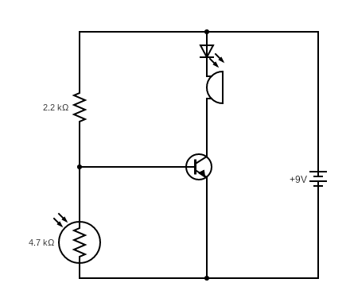
Circuit Diagram

Slide 6
Merits:
Demerits
It’s a portable system which is easy to carry and install.
It’s an efficient system with less power consumption.
The LDR used is highly sensitive for light.
The LDR used in it is low cost.
LDR is not a very robust component and can break easily.
The LDR used can be highly inaccurate.

Slide 7
Future Scope:
This project can be done at a large scale with quality components to ensure maximum security.
Instead of a buzzer the project can be connected to an actual intruder alert alarm.
The system can be connected to an online system in such a way that when intruder is detected it automatically locks all the door to prevent any further theft.

Slide 8
Thank You

